Slide 1
Faculty of Engineering Computer Civil Engineering Student: Víctor Salazar Advisor: Dr. Gustavo Gatica
2-phase algorithm using clustering and tabu search for solving the Multi-Trip Vehicle Routing Problem (MTVRP)

Slide 2



Context
Variations of the Vehicle Routing Problem (VRP)
NP-Hard Problem
High computational times

Slide 3
Multi-Trip Vehicle Routing Problem
Variation of a VRP:
Vehicles with equal capacity are available.
More than one vehicle can remain in route simultaneously.
Not all vehicles necessarily need to be utilized.
Vehicles have a maximum availability.

Slide 4
Multi-Trip Vehicle Routing Problem
Each vehicle can perform N-1 routes.
The cost of traveling from one customer to another is determined by the vehicle's travel time between points.
Loading and unloading time as well as customer service time are not considered.

Slide 5
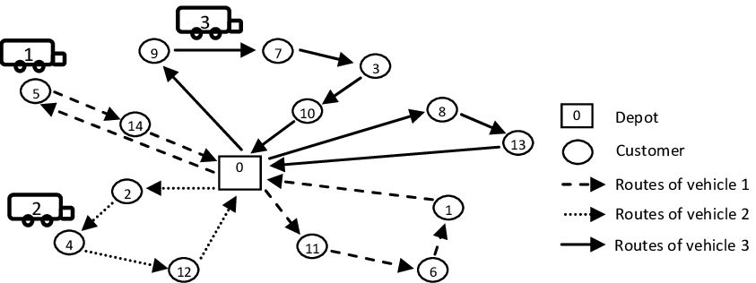
Multi-Trip Vehicle Routing Problem
Ayadi y Benadada (2013)

Slide 6
Working Hypotheses
The computational time in searching for solutions to the multiple-trip vehicle routing problem can be reduced by using clusters and tabu search.

Slide 7
Objectives
General Objective
Reduce the computation time in searching for solutions to the multiple-route vehicle routing problem.
Especific Objectives
Model the problem in AMPL to generate comparison parameters.
Efficiently divide the problem into subproblems using clusters.
Design an algorithm based on tabu search to obtain solutions for each subproblem.

Slide 8
Work Methodology
First stage: Generation of results using exact methods through mathematical modeling in AMPL.
Second stage: Generation of sub-problems
Third stage: Route search
-Fourth stage: Analysis and comparison of results.

Slide 9

Mathematical Model
4-index model adapted from the 3VFF-VRP model of Toth and Vigo (2002).
Index
v: Vehicle
r: Route
i: Initial node
j: Final node
Constants
N: Number of nodes
R: Number of routes
V: Number of vehicles
Q: Vehicle capacity
$T_{ij}$: Time from i to j
$T_{H}$: Maximum vehicle time
$Q_{i}$: Requirements of node i

Slide 10
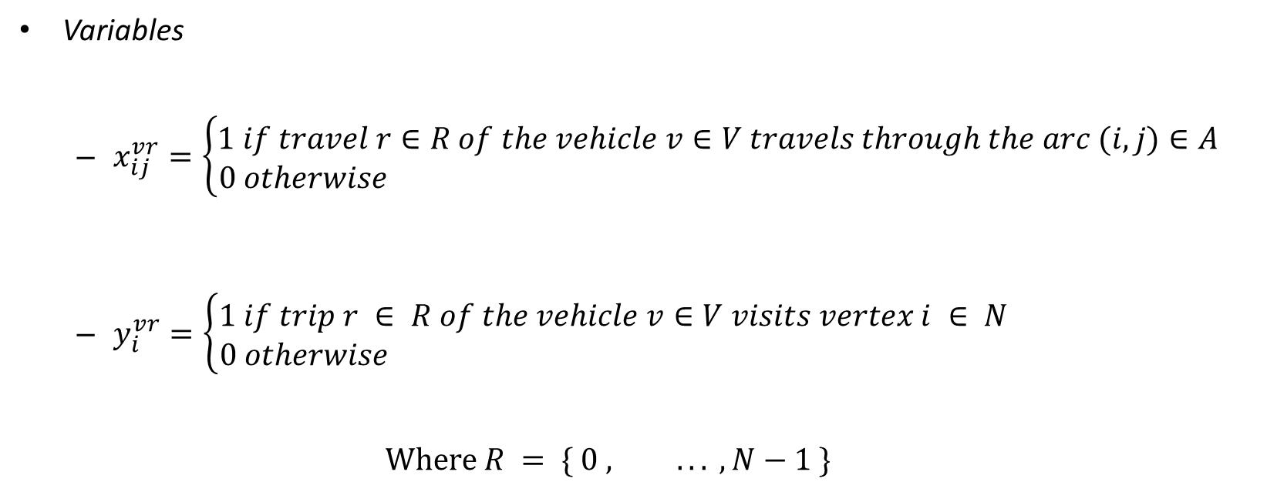
Mathematical Model
Variables
$x_{ij}^{vr}=\left\{\begin{aligned}1 if travel r∈R of the vehicle v∈V travels through the arc (i,j)∈A \\ 0 otherwise \end{aligned}\right.$
$y_{i}^{vr}=\left\{\begin{aligned}1 if trip r ∈ R of the vehicle v∈V visits vertex i ∈ N \\ 0 otherwise \end{aligned}\right.$
$$Where R = \{ 0 , ... , N−1 \}$$

Slide 11
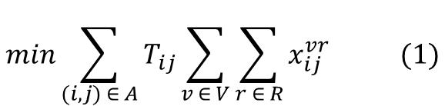
Mathematical Model
Objective Function
Minimizing total
vehicle travel time
$$min\sum_{(i,j) ∈ A}{T_{ij}}\sum_{v ∈ V}{\sum_{r ∈ R}{x_{ij}^{vr}}} (1)$$

Slide 12
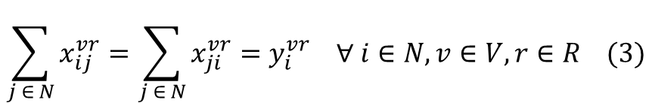
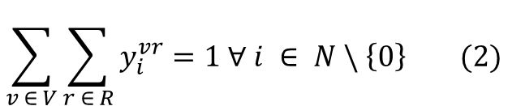
Mathematical Model
Subject to
Each node is visited only 1 time
Each node has only one input and one output, except for the depot.
$$\sum_{v ∈ V}{\sum_{r ∈ R}{y_{i}^{vr}}}=1 ∀ i ∈ N \backslash \left\{0\right\} (2)$$
$$\sum_{j ∈ N}{x_{ij}^{vr}}=\sum_{j ∈ N}{x_{ji}^{vr}}=y_{i}^{vr} ∀ i∈N, v∈V, r∈R (3)$$

Slide 13
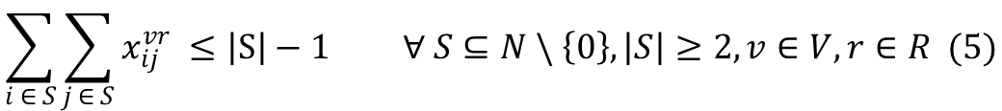
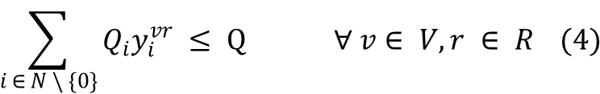
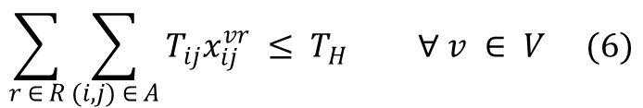
Mathematical Model
Subject to
The capacity of customers to be visited by a vehicle on a trip cannot exceed the capacity of the vehicle.
For each subset of S nodes, there must
be a route of |S|-1 or fewer nodes
to avoid sub-routes.
The total travel time of a vehicle may not exceed the established maximum time.
$$\sum_{i ∈ N \backslash \{0\}}{{Q_{i}y}_{i}^{vr} ≤ Q ∀ v∈ V, r ∈ R} (4)$$
$$\sum_{i ∈ S}{\sum_{j ∈ S}{x_{ij}^{vr}}} ≤\left|S\right|−1 ∀ S⊆N \backslash \left\{0\right\}, \left|S\right|≥2, v∈V, r∈R (5)$$
$$\sum_{r ∈ R}{\sum_{(i,j) ∈ A}{T_{ij}x_{ij}^{vr}}} ≤ T_{H} ∀ v ∈ V (6)$$

Slide 14

Mathematical Model
Subject to
Binary Variables
$x_{ij}^{rv} ∈ \{0, 1\} ∀ v∈V, r∈R, (i, j)∈A$ (7)
$$y_{i}^{rv}∈\left\{0,1\right\}∀v∈V,r∈R,i∈N (8)$$

Slide 15
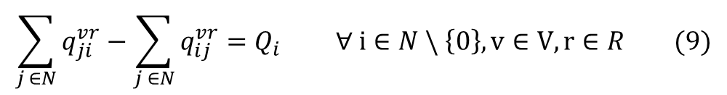
Modification of sub-route restrictions by Lei et al (2006).
$q_{ji}^{vr}$ = vehicle capacity on route r between nodes i and j
$$\sum_{j ∈N}{q_{ji}^{vr}−\sum_{j ∈N}{q_{ij}^{vr}}}=Q_{i} ∀ i∈N \backslash \left\{0\right\}, v∈V, r∈R (9)$$
Constraints 4 and 5 are replaced by constraints 9, 10 and 11, which serve both capacity control and sub-route avoidance functions.
$q_{ij}^{vr} ≤Qx_{ij}^{vr} ∀ \left(i,j\right)∈A, v∈$ V, r $∈$ R (10)
$q_{ij}^{vr} ≥0 ∀ \left(i,j\right)∈A, v∈$ V, r $∈$ R (11)

Slide 16
Proposed solution
Cluster 1
Capacity verification
Initial Clustering
Cluster 2
Capacity verification
Cluster 3
Capacity verification

Slide 17
Proposed solution
Cluster 1
Capacity verification
Initial Clustering
Cluster 2
Capacity verification
Cluster 3
Capacity verification

Slide 18
Proposed solution
Cluster 1
Capacity verification
Initial Clustering
Cluster 2
Capacity verification
Cluster 3
Capacity verification

Slide 19
Proposed solution
Cluster 1
Capacity verification
Initial Clustering
Cluster 2
Capacity verification
Cluster 3
Capacity verification

Slide 20
Proposed solution
Cluster 1
Capacity verification
Initial Clustering
Cluster 2
Capacity verification
Cluster 3
Capacity verification

Slide 21
Proposed solution
Cluster 1
Capacity verification
Initial Clustering
Cluster 2
Capacity verification
Cluster 3
Capacity verification
sub- Clustering

Slide 22
Proposed solution
Cluster 1
Capacity verification
Initial Clustering
Cluster 2
Capacity verification
Cluster 3
Capacity verification
Cluster 4
Capacity verification
sub- Clustering

Slide 23
Proposed solution
Cluster 1
Capacity verification
Initial Clustering
Cluster 2
Capacity verification
Cluster 3
Capacity verification
Cluster 4
Capacity verification
sub- Clustering

Slide 24
Proposed solution
Cluster 1
Capacity verification
Initial Clustering
Cluster 2
Capacity verification
Cluster 3
Capacity verification
Cluster 4
Capacity verification
sub- Clustering

Slide 25
Proposed solution
Cluster 1
Capacity verification
Initial Clustering
Cluster 2
Capacity verification
Cluster 3
Capacity verification
Cluster 4
Capacity verification
sub- Clustering

Slide 26
Proposed solution
Cluster 1
Capacity verification
Initial Clustering
Cluster 2
Capacity verification
Cluster 3
Capacity verification
Cluster 4
Capacity verification
sub- Clustering
Cluster 5
Capacity verification

Slide 27
Proposed solution
Cluster 1
Capacity verification
Tabú search
2-OPT
Initial Clustering
Cluster 2
Capacity verification
Tabú search
2-OPT
Cluster 3
Capacity verification
Tabú search
2-OPT
Final Solution
Cluster 4
Capacity verification
Tabú search
2-OPT
sub- Clustering
Cluster 5
Tabú search
2-OPT
Capacity verification

Slide 28
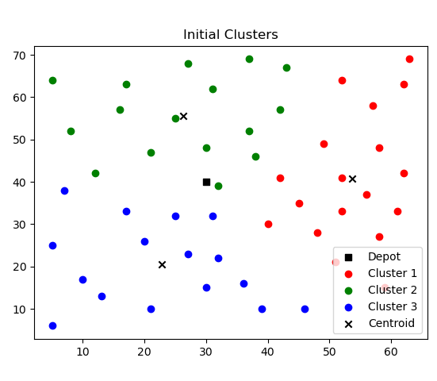
Proposed solution
Clustering
K-means
k=3
CMT-1 instance converted
using a speed of 50km/h

Slide 29
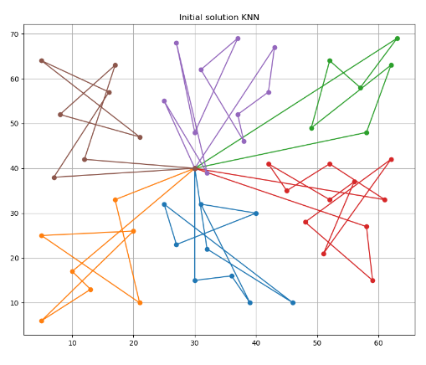
Proposed solution
Initial Solutions
K Nearest Neighbour

Slide 30
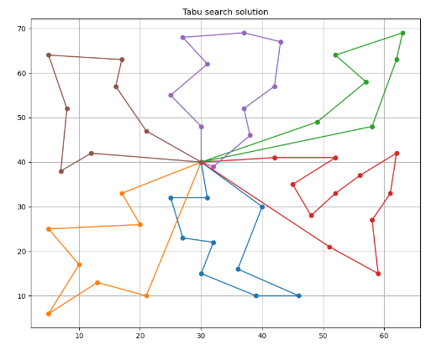
Proposed solution
Tabú search
Tabú list: 5
Neighborhood limitation
to less than average arcs

Slide 31

Proposed solution
2-OPT

Slide 32
Preliminary Results
Instance | MIN | MAX | AVE
CMT-1 | 670 | 879 | 815,7
CMT-2 | 1181 | 1652 | 1457
CMT-3 | 1193 | 1538 | 1391
CMT-11 | 1326 | 1343 | 1334

Slide 33
Preliminary Results
Instance | v | TH | Algorithm Solution | Computing Time (s) | AMPL (6 hours) | Optimum (Distance) | Optimo (Time) | GAP
CMT-1 | 1 | 692,4 | 670 | 0,48 | Not Found Solution | 524,61 | 629,53 | 6,43
 | 2 | 346,8 | 670 |  | Not Found Solution | 529 | 634,80 | 5,55
 | 4 | 172,8 | 670 |  | Not Found Solution | 546 | 655,20 | 2,26
CMT-2 | 1 | 1102,8 | 1181 | 0,62 | Out of memory | 835,26 | 1002,31 | 17,83
 | 2 | 550,8 | 1181 |  | Out of memory | 835,26 | 1002,31 | 17,83
 | 3 | 367,2 | 1181 |  | Out of memory | 835,26 | 1002,31 | 17,83
 | 4 | 276 | 1181 |  | Out of memory | 835,26 | 1002,31 | 17,83
 | 5 | 220,8 | 1181 |  | Out of memory | 835,26 | 1002,31 | 17,83
 | 6 | 183,6 | 1181 |  | Out of memory | 839,22 | 1007,06 | 17,27
CMT-3 | 1 | 1090,8 | 1193 | 0,72 | Out of memory | 826,14 | 991,37 | 20,34
 | 2 | 544,8 | 1193 |  | Out of memory | 826,14 | 991,37 | 20,34
 | 3 | 363,6 | 1193 |  | Out of memory | 826,14 | 991,37 | 20,34
 | 4 | 272,4 | 1193 |  | Out of memory | 826,14 | 991,37 | 20,34
CMT-11 | 1 | 1312,8 | 1326 | 2,7 | Out of memory | 1042 | 1250,40 | 6,05
 | 2 | 656,4 | 1326 |  | Out of memory | 1042 | 1250,40 | 6,05
 | 3 | 438 | 1326 |  | Out of memory | 1042 | 1250,40 | 6,05
 | 4 | 328,8 | 1326 |  | Out of memory | 1042 | 1250,40 | 6,05
 | 5 | 262,8 | 1326 |  | Out of memory | 1042 | 1250,40 | 6,05

Slide 34

Conclusions
Results momentarily not always feasible.
Results close to optimum in some cases.
Low computation time.
Opportunity for improvement.
Mention that this work has already been accepted in the "2024 INFORMS/ALIO/ASOCIO International Conference".

Slide 35
References
[1] B. Fleischmann, “The vehicle routing problem with multiple use of vehicles The vehicle routing problem with multiple use of the vehicles Scope and Purpose,” 1990, Accessed: Feb. 27, 2024. [Online]. Available: https://www.researchgate.net/publication/221704650
[2] C. Sánchez Gómez and A. Santana Escudero, “Optimización del multi-trip vehicle routing problem mediante el algoritmo de Clarke-Wright,” 2019.
[3] G. Laporte, S. Røpke, and T. Vidal, “Heuristics for the Vehicle Routing Problem.” Society for Industrial and Applied Mathematics, pp. 87–116, 2014. Accessed: Feb. 28, 2024. [Online]. Available: https://orbit.dtu.dk/en/publications/heuristics-for-the-vehicle-routing-problem
[4] T. Cokyasar, A. Subramanyam, J. Larson, M. Stinson, and O. Sahin, “Time-Constrained Capacitated Vehicle Routing Problem in Urban E-Commerce Delivery,” https://doi.org/10.1177/03611981221124592, vol. 2677, no. 2, pp. 190–203, Oct. 2022, doi: 10.1177/03611981221124592.
[5] D. Cattaruzza, N. Absi, and D. Feillet, “Vehicle routing problems with multiple trips,” 4OR, vol. 14, no. 3, pp. 223–259, Sep. 2016, doi: 10.1007/s10288-016-0306-2.
[6] Y. Benadada and R. Ayadi, “Memetic algorithm for a multi-objective vehicle routing problem with multiple trips Green logistic: metaheuristiques et algorithmes bio-inspirés pour la logistique verte View project MEMETIC ALGORITHM FOR A MULTI-OBJECTIVE VEHICLE ROUTING PROBLEM WITH MULTIPLE TRIPS,” 2013. [Online]. Available: https://www.researchgate.net/publication/287264078
[7] E. D. Taillard, G. Laporte, and M. Gendreau, “Vehicle Routeing with Multiple Use of Vehicles,” J Oper Res Soc, vol. 47, no. 8, p. 1065, Aug. 1996, doi: 10.2307/3010414.
[8] P. Toth and D. Vigo, “1. An Overview of Vehicle Routing Problems,” The Vehicle Routing Problem, pp. 1–26, Jan. 2002, doi: 10.1137/1.9780898718515.CH1.
[9] I. Gribkovskaia, B. O. Gullberg, K. J. Hovden, and S. W. Wallace, “Optimization model for a livestock collection problem,” International Journal of Physical Distribution and Logistics Management, vol. 36, no. 2, pp. 136–152, 2006, doi: 10.1108/09600030610656459.
[10] N. Azi, M. Gendreau, and J. Y. Potvin, “An exact algorithm for a single-vehicle routing problem with time windows and multiple routes,” Eur J Oper Res, vol. 178, no. 3, pp. 755–766, May 2007, doi: 10.1016/J.EJOR.2006.02.019.
[11] F. Alonso, M. J. Alvarez, and J. E. Beasley, “A tabu search algorithm for the periodic vehicle routing problem with multiple vehicle trips and accessibility restrictions,” Journal of the Operational Research Society, vol. 59, no. 7, pp. 963–976, 2008, doi: 10.1057/PALGRAVE.JORS.2602405.
[12] L. Lei, S. Liu, A. Ruszczynski, and S. Park, “On the integrated production, inventory, and distribution routing problem,” IIE Transactions (Institute of Industrial Engineers), vol. 38, no. 11, pp. 955–970, Nov. 2006, doi: 10.1080/07408170600862688.
[13] V. G. Glave, “The application of two clustering methods in the vehicle routing problem - A numerical example in the city of Turin,” Dec. 2023.
[14] Y. Wang, Y. Wei, X. Wang, Z. Wang, and H. Wang, “A clustering-based extended genetic algorithm for the multidepot vehicle routing problem with time windows and three-dimensional loading constraints,” Appl Soft Comput, vol. 133, p. 109922, Jan. 2023, doi: 10.1016/J.ASOC.2022.109922.
[15] J. Bernal, J. W. Escobar, J. C. Paz, R. Linfati, and G. Gatica, “A probabilistic granular tabu search for the distance constrained capacitated vehicle routing problem,” International Journal of Industrial and Systems Engineering, vol. 29, no. 4, pp. 453–477, 2018, doi: 10.1504/IJISE.2018.094267.
[16] Z. Hussain Ahmed and M. Yousefikhoshbakht, “An improved tabu search algorithm for solving heterogeneous fixed fleet open vehicle routing problem with time windows,” Alexandria Engineering Journal, vol. 64, pp. 349–363, Feb. 2023, doi: 10.1016/j.aej.2022.09.008.
[17] Z. Zhang, B. Ji, and S. S. Yu, “An Adaptive Tabu Search Algorithm for Solving the Two-Dimensional Loading Constrained Vehicle Routing Problem with Stochastic Customers,” Sustainability 2023, Vol. 15, Page 1741, vol. 15, no. 2, p. 1741, Jan. 2023, doi: 10.3390/SU15021741.
[18] B. Mardones, G. Gatica, and C. Contreras-Bolton, “A metaheuristic for the double traveling salesman problem with partial last-in-first-out loading constraints,” International Transactions in Operational Research, vol. 30, no. 6, pp. 3904–3929, Nov. 2023, doi: 10.1111/ITOR.13189.
[19] P. Palominos et al., “Chaotic Honeybees Optimization Algorithms Approach for Traveling Salesperson Problem,” Complexity, vol. 2022, 2022, doi: 10.1155/2022/8903005.
[20] M. Gendreau and J. Y. Potvin, “Tabu search,” Search Methodologies: Introductory Tutorials in Optimization and Decision Support Techniques, pp. 165–186, 2005, doi: 10.1007/0-387-28356-0_6/COVER.
[21] P. Toth and D. Vigo, “The Granular Tabu Search and Its Application to the Vehicle-Routing Problem,” https://doi.org/10.1287/ijoc.15.4.333.24890, vol. 15, no. 4, pp. 333–346, Nov. 2003, doi: 10.1287/IJOC.15.4.333.24890.
[22] M. A. Mohammed et al., “Solving vehicle routing problem by using improved K-nearest neighbor algorithm for best solution,” J Comput Sci, vol. 21, pp. 232–240, Jul. 2017, doi: 10.1016/J.JOCS.2017.04.012.
[23] P. S. Barma, J. Dutta, and A. Mukherjee, “A 2-opt guided discrete antlion optimization algorithm for multi-depot vehicle routing problem,” Decision Making: Applications in Management and Engineering, vol. 2, no. 2, pp. 112–125, Oct. 2019, doi: 10.31181/DMAME1902089B.
[24] F. Jones, R. Astudillo, B. Acosta, A. Olmedo, A. Córdova, and G. Gatica, “A Constructive Algorithm for the Split Delivery Vehicle Routing Problem (SDVRP),” Lecture Notes in Computer Science (including subseries Lecture Notes in Artificial Intelligence and Lecture Notes in Bioinformatics), vol. 13956 LNCS, pp. 245–259, 2023, doi: 10.1007/978-3-031-36805-9_17/COVER.
[25] A. Mingozzi, R. Roberti, and P. Toth, “An exact algorithm for the multitrip vehicle routing problem,” INFORMS J Comput, vol. 25, no. 2, pp. 193–207, Mar. 2013, doi: 10.1287/IJOC.1110.0495.
[26] V. François, Y. Arda, Y. Crama, and G. Laporte, “Large neighborhood search for multi-trip vehicle routing,” Eur J Oper Res, vol. 255, no. 2, pp. 422–441, Dec. 2016, doi: 10.1016/j.ejor.2016.04.065.

